Slide 1

Principal Components Analysis
Chapter 10
Notes:
Resampling methods are an indispensable tool in modern statistics. They involve repeatedly drawing samples from a training set and refitting a model of interest on each sample in order to obtain additional information about the fitted model. For example, in order to estimate the variability of a linear regression fit, we can repeatedly draw different samples from the training data, fit a linear regression to each new sample, and then examine the extent to which the resulting fits differ. Such an approach may allow us to obtain information that would not be available from fitting the model only once using the original training sample.
Resampling approaches can be computationally expensive, because they involve fitting the same statistical method multiple times using different subsets of the training data. However, due to recent advances in computing power, the computational requirements of resampling methods generally are not prohibitive. In this chapter, we discuss two of the most commonly used resampling methods, cross-validation and the bootstrap. Both methods are important tools in the practical application of many statistical learning procedures. For example, cross-validation can be used to estimate the test error associated with a given statistical learning method in order to evaluate its performance, or to select the appropriate level of flexibility. The process of evaluating a model’s performance is known as model assessment, whereas the process of selecting the proper level of flexibility for a model is known as model selection. The bootstrap is used in several contexts, most commonly to provide a measure of accuracy of a parameter estimate or of a given statistical learning method.

Slide 2
outline
What Are Principal Components?
Alternate Interpretations of Principal Components
PCA Details
Scaling the Variables
Uniqueness of the Principal Components
The Proportion of Variance Exmplained
Deciding How Many Principal Components to Use
Other Uses for Principal Components

Slide 3
Principal component analysis
Principal component analysis (PCA) is an unsupervised approach
PCA refers to the process by which principal components are computed, and the subsequent use of these components in understanding the data.
PCA also serves as a tool for data visualization

Slide 4
What are Principal Components?
PCA provides a tool find a low-dimensional representation of a data set that contains as much as possible of the variation.
PCA seeks a small number of dimensions that are as interesting as possible
interesting is measured by the amount that the observations vary along each dimension.
Each of the dimensions found by PCA is a linear combination of the p features.

Slide 5
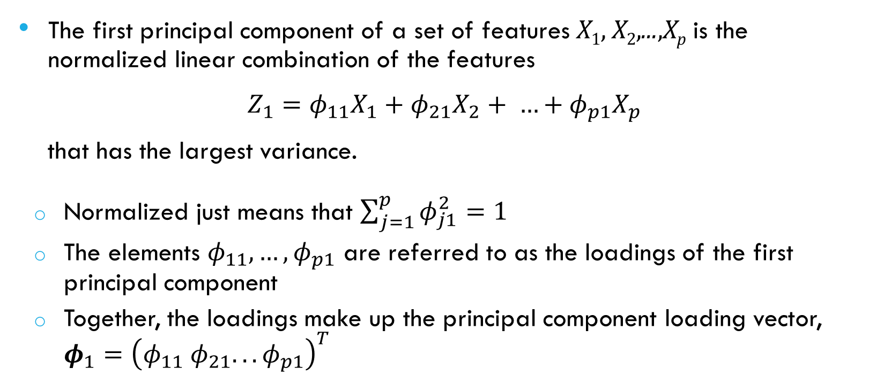
What are Principal Components?
The first principal component of a set of features X₁, X₂,...,X_{p} is the normalized linear combination of the features
$Z_{1}=φ_{11}X_{1}+φ_{21}X_{2}+ …+φ_{p1}X_{p}$
that has the largest variance.
Normalized just means that $\sum_{j=1}^{p}{φ_{j1}^{2}=1}$
The elements $φ_{11},…, φ_{p1}$ are referred to as the loadings of the first principal component
Together, the loadings make up the principal component loading vector, $φ_{1}={\left(φ_{11} φ_{21}. . . φ_{p1}\right)}^{T}$

Slide 6
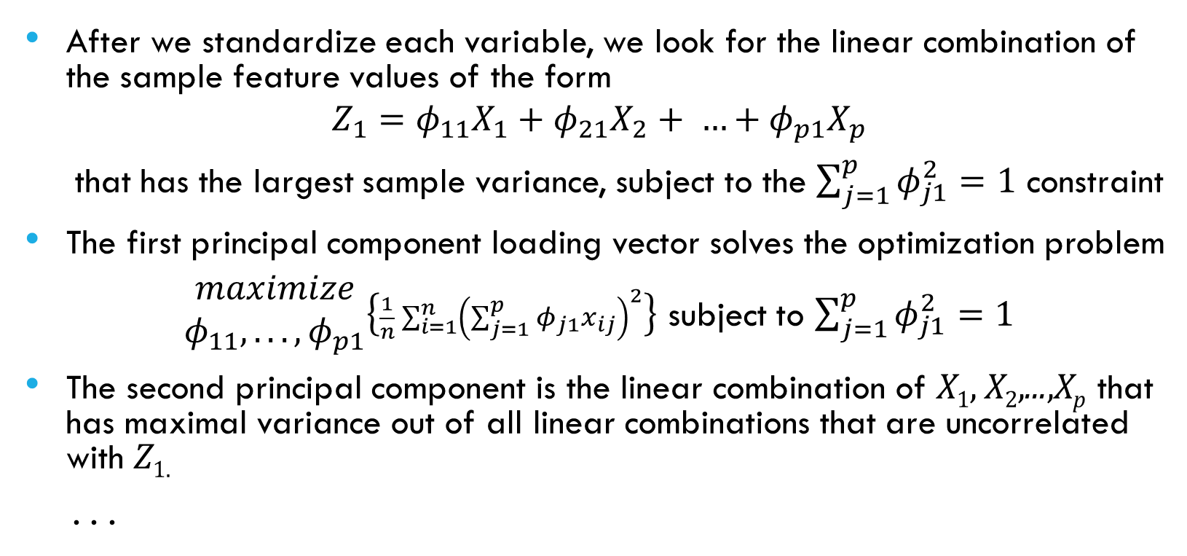
Computing the first component
After we standardize each variable, we look for the linear combination of the sample feature values of the form
$$Z_{1}=φ_{11}X_{1}+φ_{21}X_{2}+ …+φ_{p1}X_{p}$$
that has the largest sample variance, subject to the $\sum_{j=1}^{p}{φ_{j1}^{2}=1}$ constraint
The first principal component loading vector solves the optimization problem
$\begin{matrix}maximize \\ φ_{11}, . . ., φ_{p1}\end{matrix}\left\{\frac{1}{n}\sum_{i=1}^{n}{{\left(\sum_{j=1}^{p}{φ_{j1}x_{ij}}\right)}^{2}}\right\}$ subject to $\sum_{j=1}^{p}{φ_{j1}^{2}=1}$
The second principal component is the linear combination of X₁, X₂,...,X_{p} that has maximal variance out of all linear combinations that are uncorrelated with Z_{1.}
. . .

Slide 7
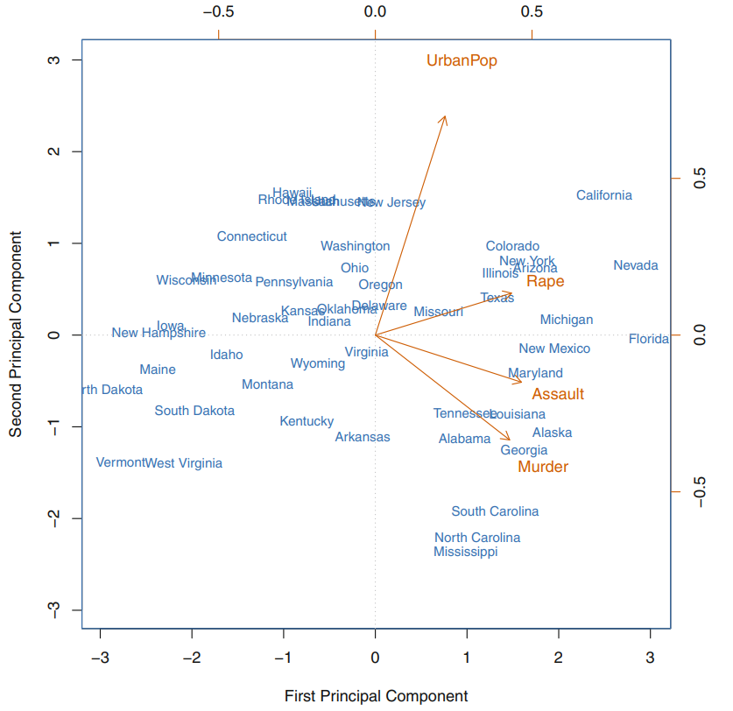
Example: USArrests Data
 | PC1 | PC2
Murder | 0.5358995 | −0.4181809
Assault | 0.5831836 | −0.1879856
UrbanPop | 0.2781909 | 0.8728062
Rape | 0.5434321 | 0.1673186

Slide 8
Another interpretation of Principal Components
Principal components provide low-dimensional linear surfaces that are closest to the observations
The first principal component loading vector is the line in p-dimensional space that is closest to the n observations (using average squared Euclidean distance as a measure of closeness)
The first two principal components of a data set span the plane that is closest to the n observations
The first M principal component score vectors and the first M principal component loading vectors provide the best M-dimensional approximation (in terms of Euclidean distance) to the ith observation x_{ij} .

Slide 9
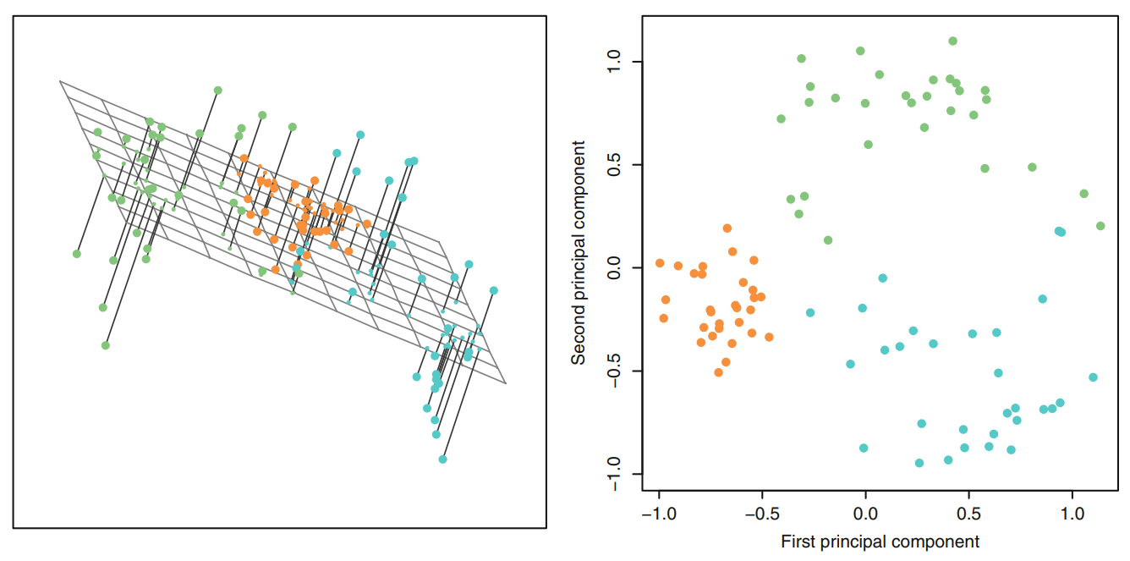
Another interpretation of Principal Components

Slide 10
Scaling the variables
The variables should be centered to have mean zero before PCA is performed.
The results obtained will depend on whether the variables have been individually scaled (each multiplied by a different constant)
Sometimes, our variables may be measured in the same units. In this case, we might not wish to scale the variables to have standard deviation one before performing PCA

Slide 11
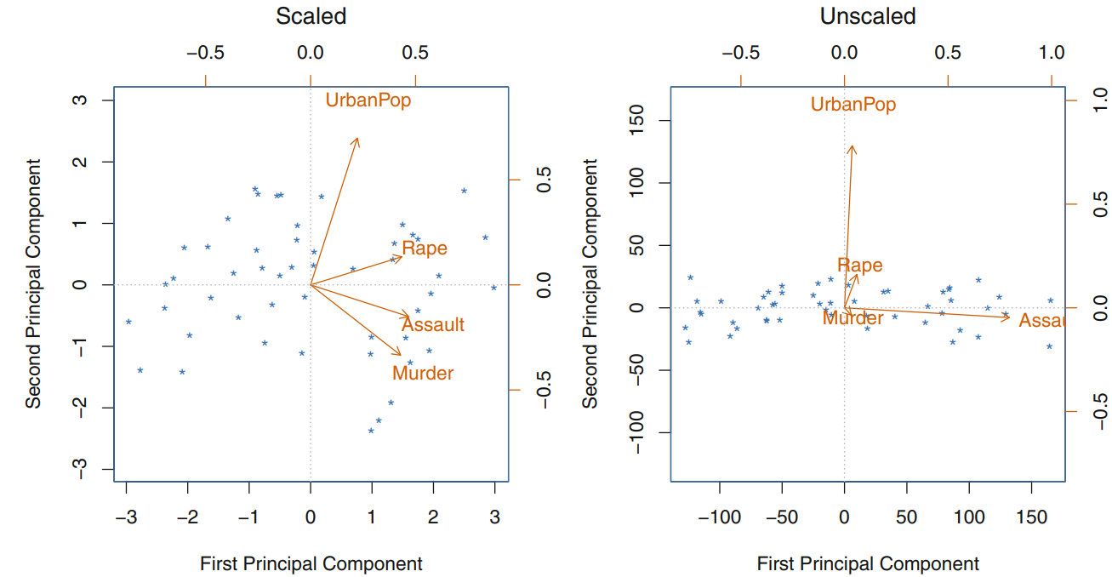
Scaling the variables

Slide 12
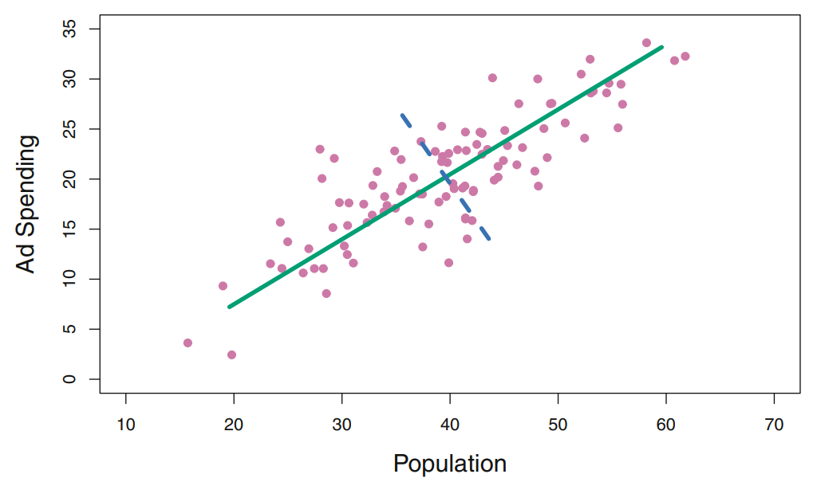
Uniqueness of the Principal Components
Each principal component loading vector is unique
The signs may differ because each principal component loading vector specifies a direction in p-dimensional space: flipping the sign has no effect as the direction does not change.

Slide 13
The Proportion of Variance Explained

Slide 14
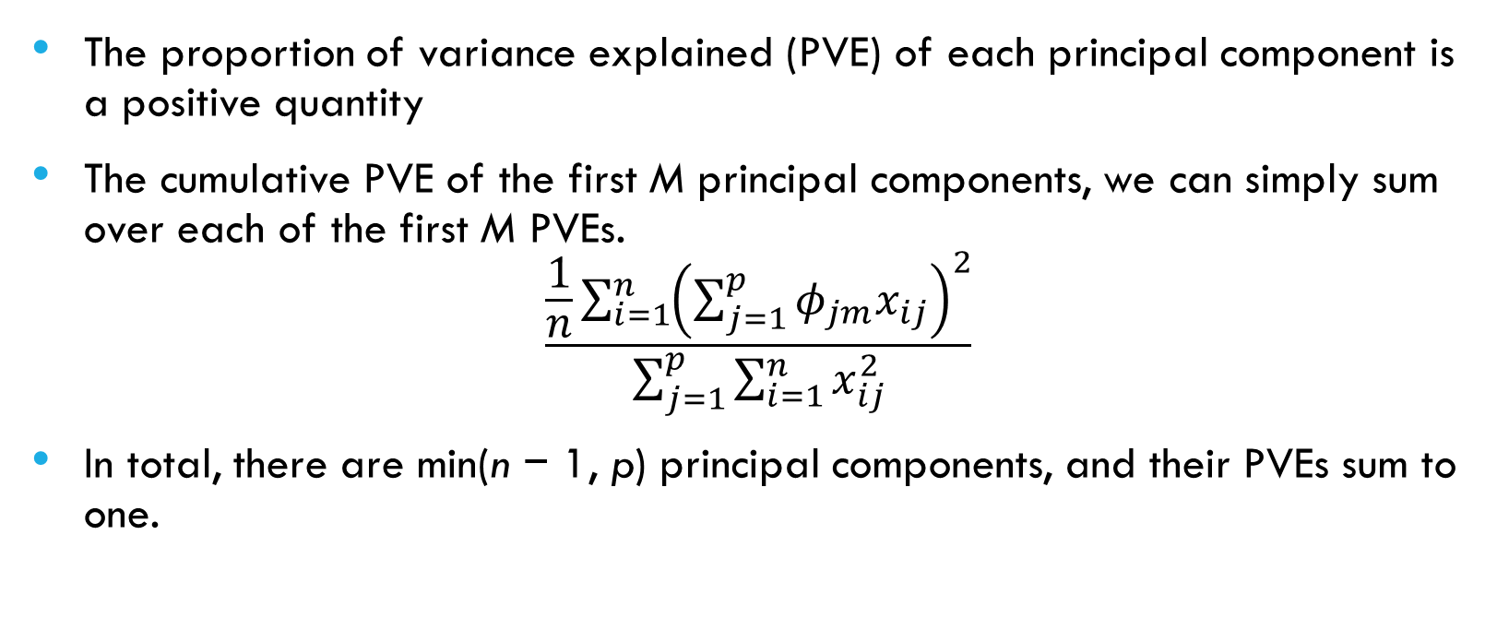
The Proportion of Variance Explained
The proportion of variance explained (PVE) of each principal component is a positive quantity
The cumulative PVE of the first M principal components, we can simply sum over each of the first M PVEs.
$$\frac{\frac{1}{n}\sum_{i=1}^{n}{{\left(\sum_{j=1}^{p}{φ_{jm}x_{ij}}\right)}^{2}}}{\sum_{j=1}^{p}{\sum_{i=1}^{n}{x_{ij}^{2}}}}$$
In total, there are min(n − 1, p) principal components, and their PVEs sum to one.

Slide 15
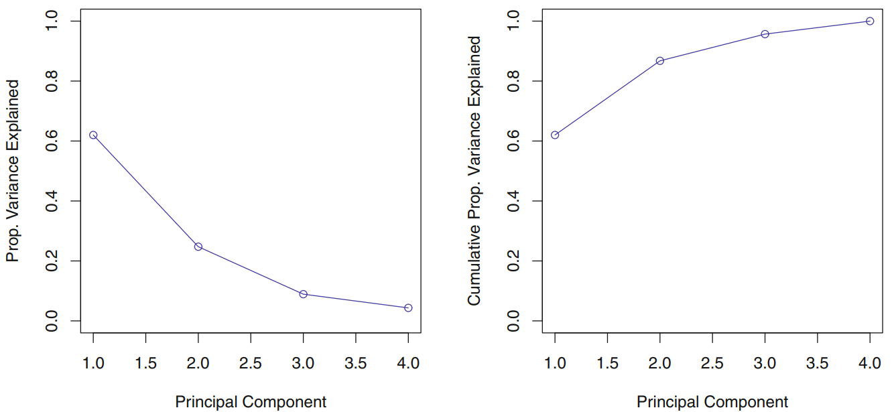
The Proportion of Variance Explained

Slide 16
Deciding How Many Principal Components to Use
We would like to use the smallest number of principal components required to get a good understanding of the data.
We choose the smallest number of principal components that are required in order to explain a sizeable amount of the variation in the data
Unfortuneately, there is no well-accepted and objective way to decide how many principal components are enough
In practice, we tend to look at the first few principal components in order to find interesting patterns in the data.
If no interesting patterns are found in the first few principal components, then further principal components are unlikely to be of interest.
If the first few principal components are interesting, then we typically continue to look at subsequent principal components until no further interesting patterns are found.
Supervised Learning: we can treat the number of principal component score vectors to be used in the regression as a tuning parameter to be selected via cross-validation or a related approach

Slide 17
Other Uses for Principal Components
Many statistical techniques can be easily adapted to use principal component score vectors
To perform principal component regression, we simply use principal components as predictors in a regression model in place of the original larger set of variables
This can lead to less noisy results, since it is often the case that the signal (as opposed to the noise) in a data set is concentrated in the first few principal components

